Slide 1
DIGITAL Portfolio
STUDENT NAME:Kamalam R
REGISTER NO AND NMID: 24131130500122007/asanm11324131130500122007
DEPARTMENT: BCA
COLLEGE: 113-Vallalar Arts and Science College,Annamalai University

Slide 2
PROJECT TITLE RESUME DIGITAL PORTFOLIO

Slide 3


AGENDA
Problem Statement
Project Overview
End Users
Tools and Technologies
Portfolio design and Layout
Features and Functionality
Results and Screenshots
Conclusion
Github Link
3/21/2024 Annual Review

Slide 4

PROBLEM STATEMENTS:
Traditional resumes are often static documents that lack visual appeal and the ability to demonstrate practical skills, leaving employers with limited insight into a candidate's true abilities.

Slide 5

PROJECT OVERVIEW: A "project overview" for a digital portfolio is a concise description of a project's key aspects, typically including its purpose, your role and responsibilities, the methods you used, the results or impact achieved, and any valuable lessons learned. CONTAINS FOR OUR PORTFOLIO: *ABOUT ME *PORTFOLIO *PROJECT *CONTANT

Slide 6

END USERS: The end users for a resume digital portfolio template include job seekers, who use it to create a personal brand and showcase their skills to potential employers, and employers and recruiters who use it to review candidates, understand their experience, and assess their suitability for a role.

Slide 7

Tools and Technologies: *HTML Structure (pages, sections). *CSS Styling (colors, layouts, responsiveness). *JavaScript Interactivity (navigation menu, animations, form validation). *Mention code editor (VS Code) or CODEPEN and hosting platform (GitHub Pages). .

Slide 8
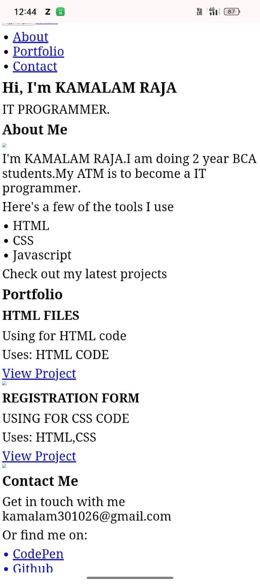
POTFOLIO DESIGN AND LAYOUT:
*ABOUT ME:
INTRODUCTION FOR OUR SELF.
*PORJECT USING FOR TOOLS:
HTML
CSS
JAVASCRIPT
*PROJECTS:
HTML CODE
REGISTRATION FORM
*CONTANT:
EMAIL ID
8

Slide 9

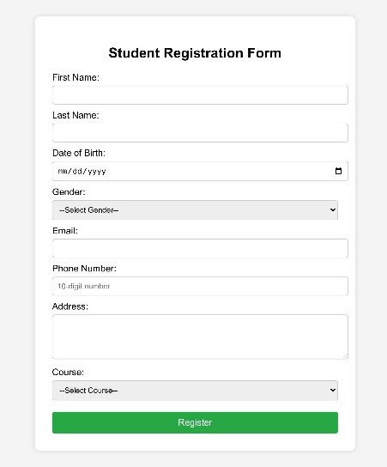
FEATURES AND FUNCTIONALITY: * Students can create and manage their personal profiles. * Add details like name, photo, contact info, career objectives, and education background.

Slide 10
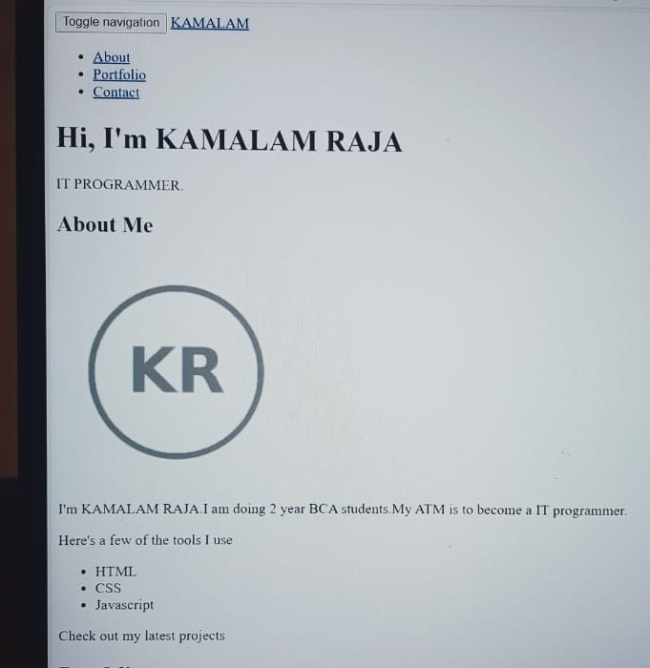
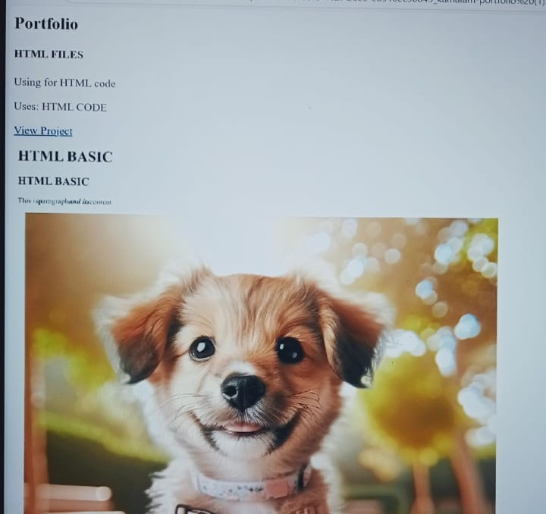
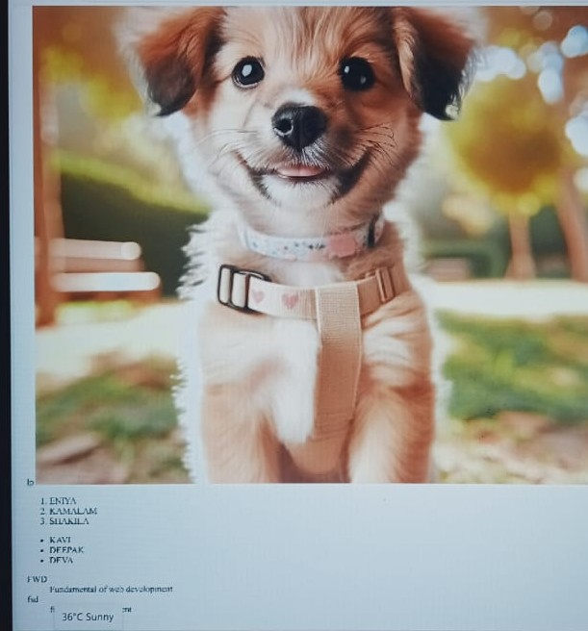

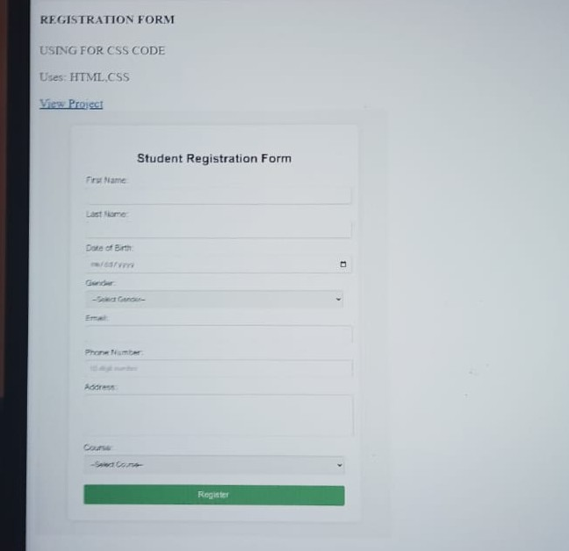
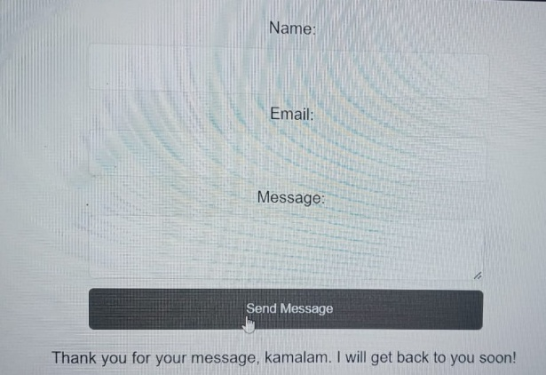
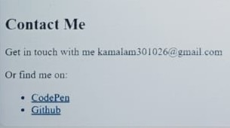
RESULTS AND SCREENSHOTS:
3/21/2024 Annual Review
10

Slide 11
CONCLUSION: A conclusion for your resume's digital portfolio section should emphasize that it provides crucial tangible proof of your skills, a window into your professional capabilities, and a powerful way to showcase your personality and brand beyond a traditional resume. GITHUB LINK: https://github.com/kamalam301026-coder/kamalam-TNSDC-FWD-DP.git !________THANK YOU_______!
11

